Slide 1
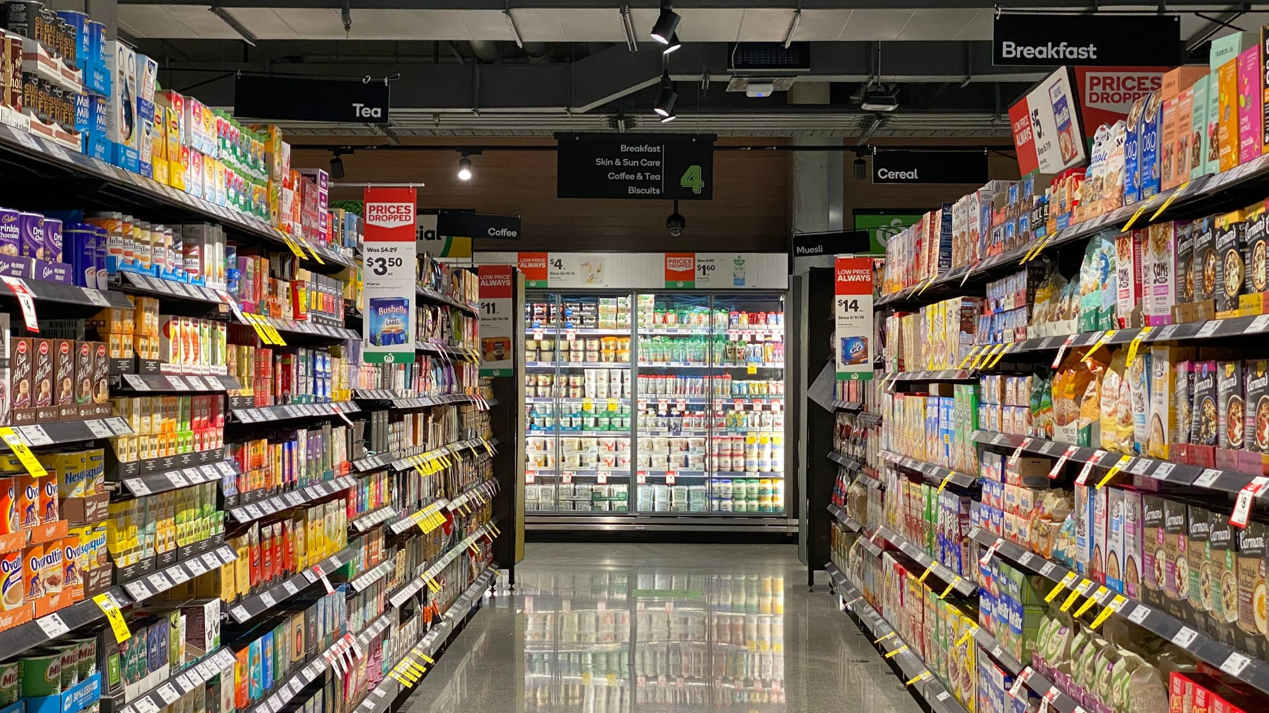
Inven
INVENTORY MANAGEMENT SYSTEM

Slide 2
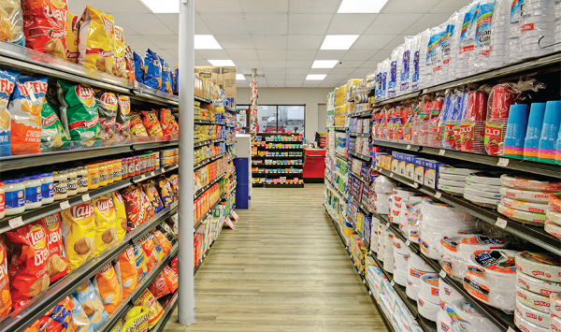
Project Significance
The purpose of our project was driven by the need to harness the power of data analysis to decipher product trends and, in turn, construct a robust system for effective inventory management. In any retail setting, and particularly in a supermarket environment, understanding and adapting to product trends is a pivotal aspect of staying ahead in the market.
Our first priority was to carefully examine the historical sales data for each product to find trends, recognize seasonality, and ascertain customer preferences.
Using the insights from our data analysis, our next step of action was to construct a predictive model capable of forecasting future sales. The core objective was to leverage this forecasting capability to proactively manage our stock levels, ensuring that we never run out of products.
The data used for our analysis was one year product sales data from a local chain store.

Slide 3
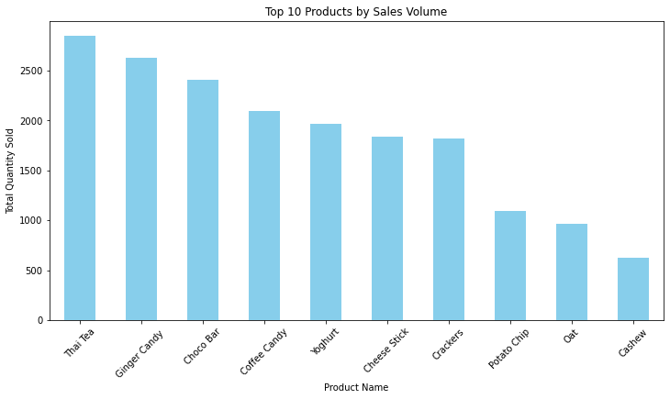
Sales Volume
The metrics used for our analysis were:
1. Popular products : Determining which products have the highest sales volume or revenue.
2. Sales trends :
Analyzing how sales have changed over time.
3. Sales seasonality :
Identifying any patterns or trends that repeat over a specific period (e.g., monthly, quarterly, annually).
Top 5 Products by Sales Volume:
1. Thai Tea
2. Ginger Candy
3. Choco Bar
4. Coffee Candy
5. Yoghurt

Slide 4
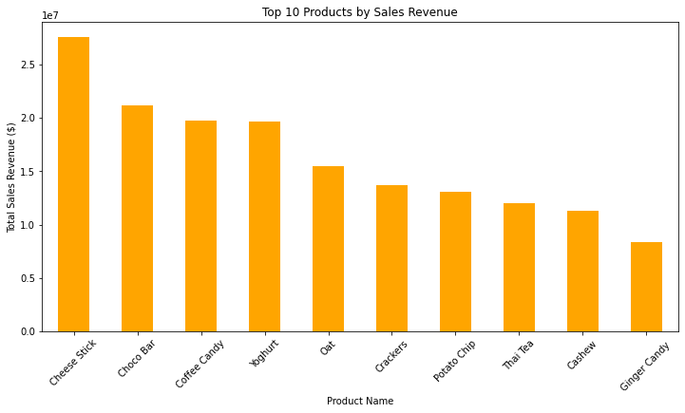
Sales Revenue
This visualizations shows which products are most popular in terms of total sales revenue.
'Cheese Stick' and 'Choco Bar' are particularly notable for their high revenue generation , with the highest revenue generators being :
1. Cheese Stick
2. Choco Bar
3. Coffee Candy
4. Yoghurt
5. Oat

Slide 5
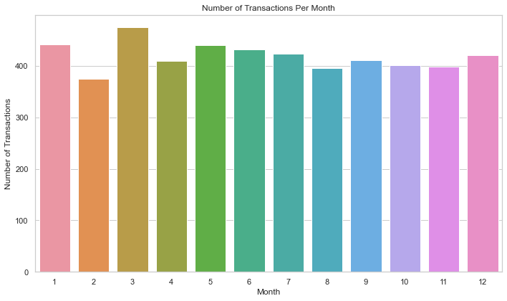
Monthly Transactions
Transaction Volume by Month: The chart suggests a variation in the number of transactions across different months. The highest number of transactions occurs in the 2nd month, and the lowest is seen in the 6th month.
Possible Seasonality: There may be seasonality in the transaction data, with certain months consistently seeing higher or lower transaction volumes. For example, months 1, 2, 11, and 12 show higher transaction volumes which could indicate seasonal peaks.
Product/Service Review: The months with fewer transactions might be a good time to review the product or service offerings or customer service touchpoints to understand if improvements can be made.

Slide 6
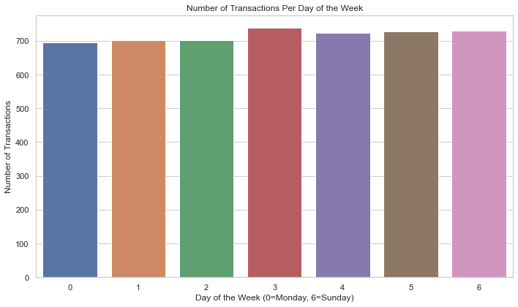
Weekly Transactions
Transaction Distribution: The transactions are fairly evenly distributed across the days of the week, with no single day showing a dramatically higher or lower number of transactions compared to the others.
Mid-Week Peak: There is a slight peak on the third day of the week (Wednesday), which may indicate mid-week is a slightly more popular time for transactions.
Weekend Analysis: The number of transactions does not drop significantly on the weekend (days 5 and 6), suggesting that consumer purchasing behavior remains consistent through the end of the week.
Marketing Strategies: Since there is no dramatic fluctuation, daily marketing efforts could be uniform throughout the week. However, slightly increased efforts on Wednesday could capitalize on the mid-week peak.
In conclusion, while there are slight variances in transactions per day, the overall distribution is quite balanced. This suggests that the marketing team could implement a consistent daily strategy with the potential for small adjustments to optimize for the slight mid-week peak.

Slide 7
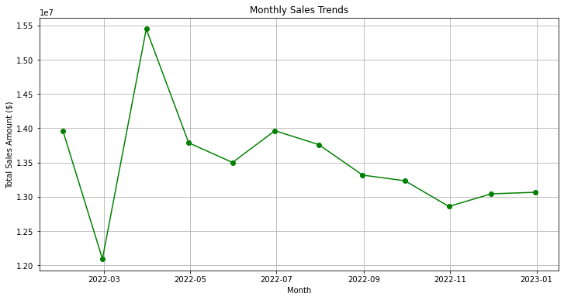
Monthly Transactions
Our analysis identified sales seasonality behavior over varied time ,any patterns or trends that repeat over a specific period (eg., monthly, quarterly, annually).
We started by:
1. Aggregating sales data monthly, quarterly, and annually.
2. Analyzing trends and patterns in these time frames.
3. Visualizing the results to identify any recurring patterns or significant insights.
The plot is a visual representation of total transactions over time.

Slide 8
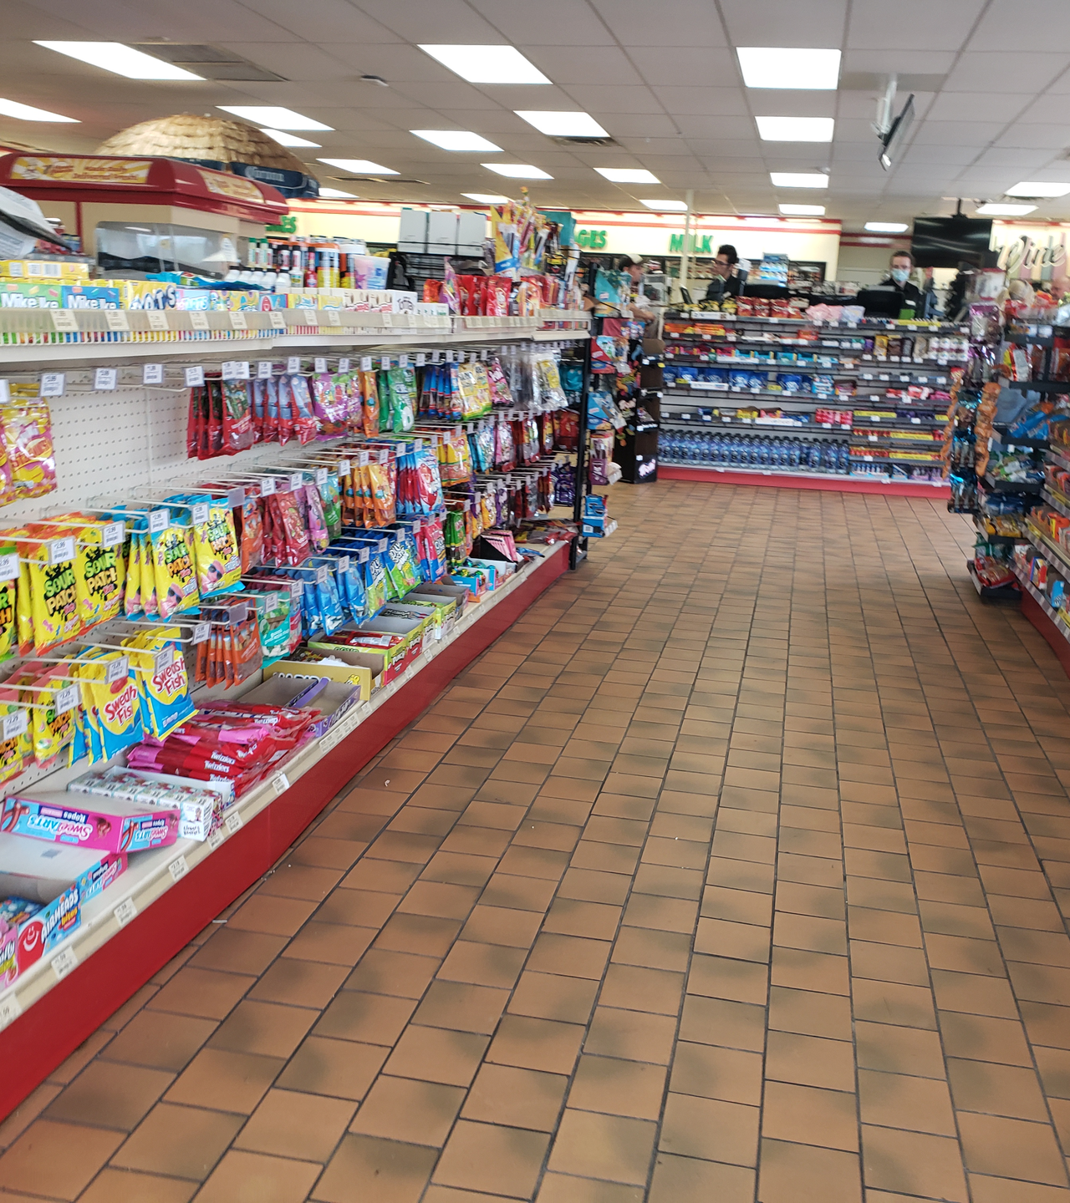
INSIGHTS
Seasonal Variations:
Peak in sales around the second month which suggests a possible seasonal influence or a special event that caused a temporary increase in sales. This could be related to a holiday period, a major sales event, or a successful marketing campaign.
Sales Decline:
After the peak, there is a noticeable decline in the following month, which is quite sharp. This might indicate that the peak was indeed due to a one-time event or that there was an inventory or stock issue following the high-demand period.
Recovery and Fluctuations:
Following the sharp decline, sales seem to recover but do not reach the previous peak. There is some fluctuation with a general downward trend. This could imply that the market is facing some instability or that consumer demand is waning for the products offered

Slide 9
INSIGHTS
Overall Trend:
The overall trend from the start to the end of the period seems to be slightly downward, despite the fluctuations. This might indicate a need for concern and could be a point of focus for the business to investigate further.
Implications for Business Strategy:
Depending on the cause of the peak and subsequent decline, the business might need to consider diversifying its products, adjusting pricing, improving supply chain resilience, or enhancing marketing efforts to smooth out such volatility.

Slide 10
MODELLING
After testing out different models, we ended up settling for the ensemble model , which was a combination of our RNN and E2D2 model.
Through averaging of both projects outcomes, were able to make one year sales predictions and used this predictions to create an Inventory Manager class.
Upon instantiation, the class takes in the initial inventory level and the safety stock threshold, two parameters that lay the foundation for effective inventory control.

Slide 11
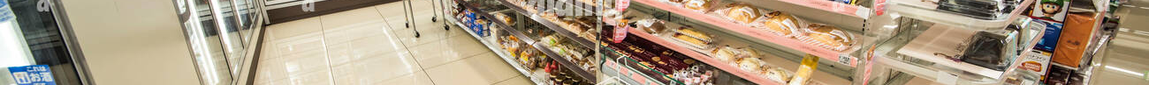
The sale method, which is expected to work seamlessly with the forecasted data simulates the reduction of inventory due to product sales, taking as input the predicted daily sales for a week.
It also includes a crucial check for stockout conditions which lets us know when the inventory level falls below the safety stock threshold

Slide 12
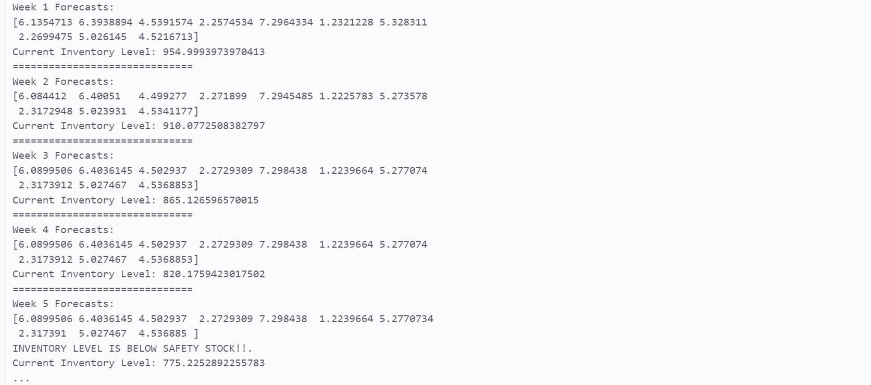
TESTING ON PROXY
We tested our class on a proxy safety stock of 800 and an initial stock of 1000 and it was able to give us warnings on whether our stock was enough or not. From analysis of the results, assuming there was no restock, by week 5 the forecasted sales are already greater than the inventory level, causing the inventory to fall below the safety stock , therefore sending the low inventory warning.

Slide 13
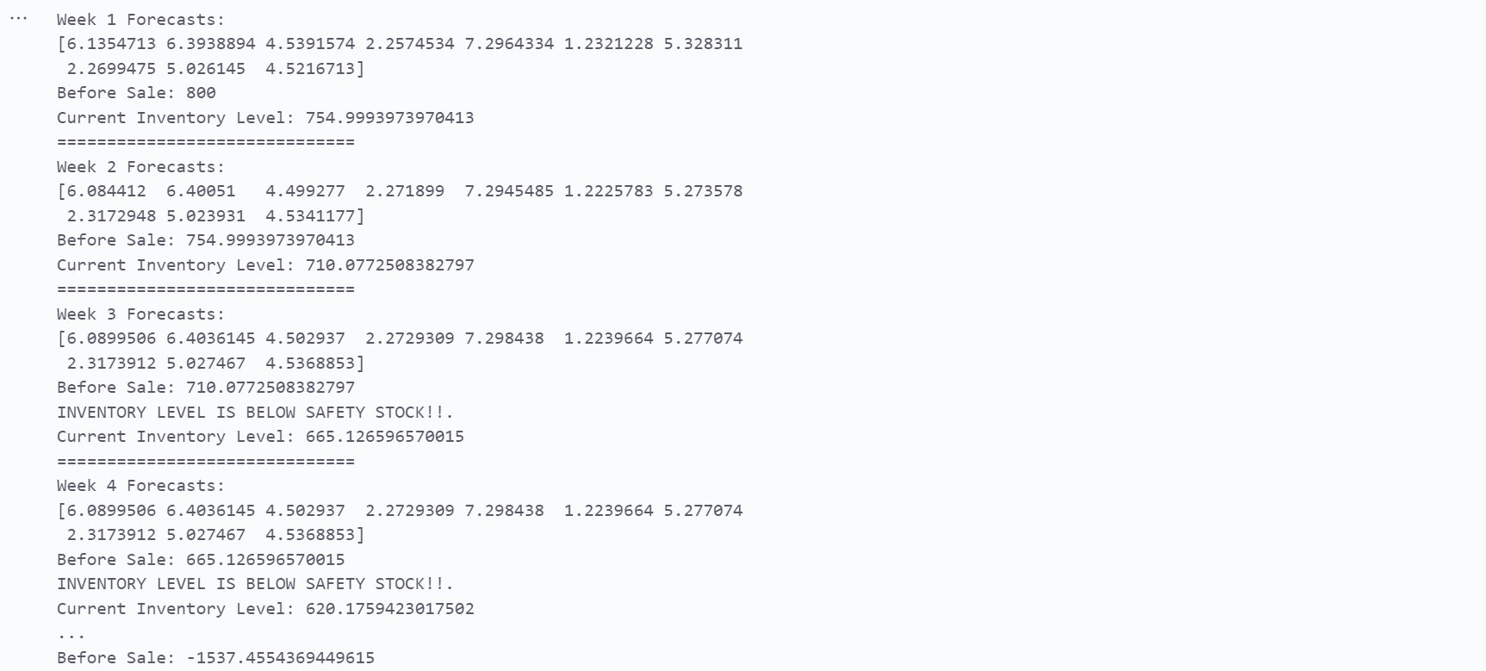
TESTING ON PROXY
We carried out a test on our class with a proxy safety stock of 700 and an initial stock of in 800 . In Week 3 the inventory goes beyond the safety stock levels. The sales are greater than the available inventory, leading to a negative inventory level.

Slide 14
Modelling
Challenges during modelling
Despite experimenting with various models and prediction methods , the biggest challenge has been the models still generating similar forecast values. Despite the ensemble model generating different results, we find that the results are very close in value. One main reason for this would be not having enough historical data as the data we are working on only has sales for one year making it not enough for the models to determine patters in the data.
Recommendations
Collect more data for our analysis

Slide 15

Thank You!

